Slide 1

Functions
Coding for Writers: Basic Programming
Code that does stuff

Slide 2
Introduction
This lesson covers
What are functions?
Passing data in and out of functions
Creating and using functions
Function parameters
Return values
Local and global variables

Slide 3
What are Functions?
You've already had some experience creating and using them in the exercises
Creating: onclick functions
Using: Number() function
Functions started off like the functions in high school algebra, but they evolved into something different
Functions are groups of code used to:
React to events
Make code easier to understand
Reuse code so that it's not duplicated
y = f(x)

Slide 4
Data in and out
You can pass data into functions
Any number of values, separated by commas
These go in the parentheses
They are called parameters
Functions can optionally return one value
This value can be any type.
This is called the return value.

Slide 5
Creating a Function
The first line declares what the function is: name, parameters, and (sometimes) what is returned
The code is then in curly brackets { }
Within the code, use the return keyword to return data
JavaScript example:
function squareRoot(x) {
return Math.pow(x, 0.5);
}

Slide 6
Using a Function
Then, when you use it, you call the function and put the data to be passed inside the parentheses.
JavaScript example:
var sqRoot2 = squareRoot(2);

Slide 7
Parameters
When you create a function, the parameters act like local variables.
For example, a function that sets the width of a UI element:
function setWidth(uiElement, newWidth) {
uiElement.width = newWidth;
}
When you call the function like this:
setWidth(logoImage, 100);
It's as if it calls these lines before the rest of the code in the function:
var uiElement = logoImage;
var newWidth = 100;

Slide 8
Dynamically and statically typed
In dynamically typed languages, like JavaScript, you don't need to say what the type of data is that is being passed in or returned
function average(num1, num2) { ...
In statically-typed languages (C, C++, Java, C#, etc.), you:
Start by saying what type of data is returned
Then the name of the function
Then a list of parameter types and names
float average(int num1, int num2) { ...
If function doesn't return anything, then use the void type
void sendMessage(string message) { ...

Slide 9
Function names
Function names follow the same rules as variable names
Numbers, letters, underscores. Nothing else.
Can't start with a number.
Use camel case (or underscores) to represent multiple words
Be clear in your meaning
Typically a verb
Examples: connectToDevice, deleteUser, etc

Slide 10
Return
When you are ready to return a value, use the return keyword
Example: return errorMessage;
You can have more than one return line in a function
Once the computer executes a return, it ends the function
If your function doesn't return a value, then:
Simply don't have a return line. It will return at the end.
Use return with nothing following it, and it will return immediately.

Slide 11
Local and global variables
Local
Declared in a function
Only exists in that function
Two functions can have variables of the same name, and they are different
Global
Declared outside the function (usually at the top)
Changes made in one function affect use in other functions

Slide 12
Local and global variables, continued
Local
function myFunction() {
var count = 0;
count++;
...
}
function otherFunction() {
var count = 0;
count--;
...
}
Global
var count = 0;
function myFunction() {
count++;
...
}
function otherFunction() {
count--;
...
}

Slide 13
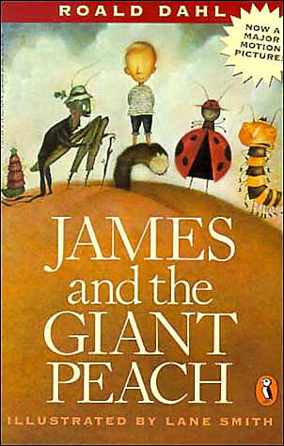

Local Variables
Imagine your functions are like books, and your variables are like characters.
Something that happens to James in one book does not affect James in the other.
This is like a local variable in a function.

Slide 14


Global Variables
However, in a series, what happens to Harry in one book affects Harry in another book.
This is like a global variable in a program.

Slide 15
Review
Functions are blocks of code that are used to react to events, make code easier to understand, and re-use code to avoid duplication
You can pass in any number of values to a function, called parameters
Functions can return one value
To create a function, declare its name and parameters
To use a function, call it with its name and the parameter values in parentheses
Parameters act like variables in a function
Function names have similar rules to variable names
Use return to return a value
Local variables are different for each function. Global variables are the same variable for all functions.

